Slide 1

UNIT 1 Overview of Language Processing System tools
-Deepali M. Raikar

Slide 2
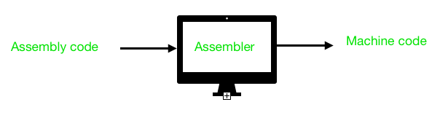
Assemblers
An assembler is a program that takes basic computer instructions and converts them into a pattern of bits that the computer's processor can use to perform its basic operations. Some people call these instructions assembler language and others use the term assembly language.

Slide 3
Assembler is a program for converting instructions written in low-level assembly code into relocatable machine code and generating along information for the loader.
It generates instructions by evaluating the mnemonics (symbols) in operation field and find the value of symbol and literals to produce machine code.
Now, if assembler do all this work in one scan then it is called single pass assembler, otherwise if it does in multiple scans then called multiple pass assembler. Here assembler divide these tasks in two passes:

Slide 4
Macroprocessor
A macro processor is a program that reads a file (or files) and scans them for certain keywords. When a keyword is found, it is replaced by some text. The keyword/text combination is called a macro.
A simple example is the C language preprocessor. When you write
#define MAX_BANANAS 6
int banana;
for (banana = 0; banana < MAX_BANANAS; banana++){
...;
}
in a C program, the C preprocessor reads the first line and stores it as a macro definition. When it comes across the later reference to MAX_BANANAS in the for loop, it replaces it with the macro's definition, 6. The output of the C preprocessor is then fed to the C compiler proper.

Slide 5
Silent features of Macro Processor:
Macro represents a group of commonly used statements in the source programming language.
Macro Processor replace each macro instruction with the corresponding group of source language statements. This is known as expansion of macros.
Macro Processor involves definition, invocation and expansion.

Slide 6
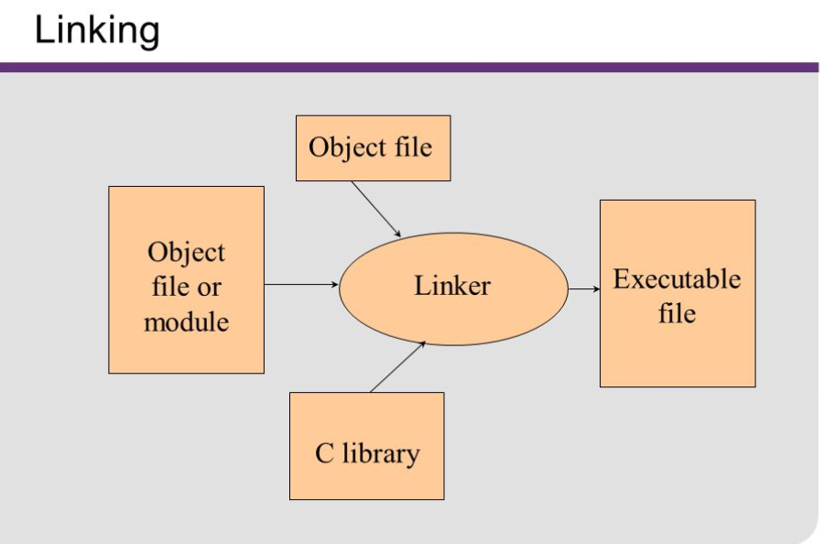
Linkers
In computing, a linker or link editor is a computer system program that takes one or more object files (generated by a compiler or an assembler) and combines them into a single executable file, library file, or another 'object' file.

Slide 7
Linker is a program in a system which helps to link a object modules of program into a single object file.
It performs the process of linking. Linker are also called link editors.
Linking is process of collecting and maintaining piece of code and data into a single file.
Linker also link a particular module into system library. It takes object modules from assembler as input and forms an executable file as output for loader.

Slide 8
Linking is of two types: 1. Static Linking – It is performed during the compilation of source program. Linking is performed before execution in static linking. It takes collection of relocatable object file and command-line argument and generate fully linked object file that can be loaded and run.

Slide 9
2. Dynamic linking – Dynamic linking is performed during the run time. This linking is accomplished by placing the name of a shareable library in the executable image. There is more chances of error and failure chances. It require less memory space as multiple program can share a single copy of the library.
Here we can perform code sharing. it means we are using a same object a number of times in the program.
The shared library needed in the linking is stored in virtual memory to save RAM.

Slide 10
Loaders
In computer systems a loader is the part of an operating system that is responsible for loading programs and libraries. It is one of the essential stages in the process of starting a program, as it places programs into memory and prepares them for execution.

Slide 11
A loader is a major component of an operating system that ensures all necessary programs and libraries are loaded, which is essential during the startup phase of running a program.
It places the libraries and programs into the main memory in order to prepare them for execution.

Slide 12
Debugger
A debugger is a software program used to test and find bugs (errors) in other programs.
A debugger is also known as a debugging tool.
A debugger is a computer program used by programmers to test and debug a target program.
Debuggers may use instruction-set simulators, rather than running a program directly on the processor to achieve a higher level of control over its execution.
This allows debuggers to stop or halt the program according to specific conditions. However, use of simulators decreases execution speed.

Slide 13
When a program crashes, debuggers show the position of the error in the target program. Most debuggers also are capable of running programs in a step-by-step mode, besides stopping on specific points. They also can often modify the state of programs while they are running.

Slide 14
Text Editors
A text editor is a type of computer program that edits plain text. ... Text editors are provided with operating systems and software development packages, and can be used to change files such as configuration files, documentation files and programming language source code.

Slide 15
A text editor is any word processing program that you can use to type and edit text.
Word Pad and NotePad for Windows and SimpleText and TextEdit for the Mac are common text editors.
Larger programs such as Microsoft Word and Word Perfect are also text editors, but they have many more features.

Slide 16
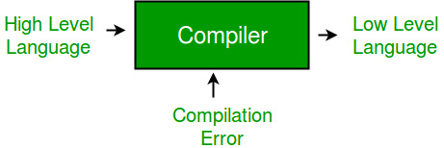
Compiler
Compiler is a software which converts a program written in high level language (Source Language) to low level language (Object/Target/Machine Language).

Slide 17
Cross Compiler that runs on a machine ‘A’ and produces a code for another machine ‘B’. It is capable of creating code for a platform other than the one on which the compiler is running.
Source-to-source Compiler or transcompiler or transpiler is a compiler that translates source code written in one programming language into source code of another programming language.

Slide 18
Interpreter
Humans can only understand high-level languages, which are called source code. Computers, on the other hand, can only understand programs written in binary languages, so either an interpreter or compiler is required.
Programming languages are implemented in two ways: interpretation and compilation. As the name suggests, an interpreter transforms or interprets a high-level programming code into code that can be understood by the machine (machine code) or into an intermediate language that can be easily executed as well.

Slide 19
The interpreter reads each statement of code and then converts or executes it directly. In contrast, an assembler or a compiler converts a high-level source code into native (compiled) code that can be executed directly by the operating system (e.g. by creating a .exe program).
In most cases, a compiler is preferable since its output runs much faster compared to a line-by-line interpretation. Rather than scanning the whole program and translating it into machine code like a compiler does, the interpreter translates code one statement at a time.

Slide 20
Interpreter Vs Compiler
Interpreter | Compiler
Translates program one statement at a time. | Scans the entire program and translates it as a whole into machine code.
Interpreters usually take less amount of time to analyze the source code. However, the overall execution time is comparatively slower than compilers. | Compilers usually take a large amount of time to analyze the source code. However, the overall execution time is comparatively faster than interpreters.
No intermediate object code is generated, hence are memory efficient. | Generates intermediate object code which further requires linking, hence requires more memory.
Programming languages like JavaScript, Python, Ruby use interpreters. | Programming languages like C, C++, Java use compilers.

Slide 21
References
Text book-Compiler Design-Dr. R. Venkatesh
Technopedia.com
www.geeksforgeeks.org
Wikipedia
Techterms.com

Slide 22
THANK YOU

